Slide 1
290 Final Presentation
Energy Optimization Using Machine Learning
Eric Lo, Lihui Ji, Zihui Xu, Dan Zhao, Jingtong Zhao
Notes:
https://hornsdalepowerreserve.com.au/overview/

Slide 2
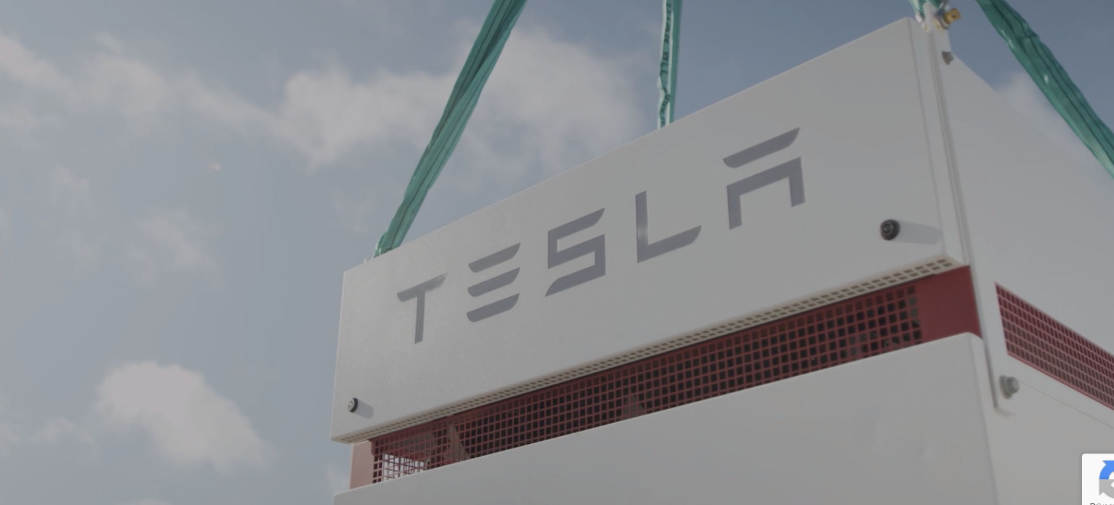
Background (Hornsdale Power Reserve)
Our project aims to support the Hornsdale Power Reserve to optimize their revenue in power storage and power charging system.
Hornsdale Power Reserve:
to provide large amount of dispatchable renewable energy
to stabilize the energy price in the electricity market
Tesla Powerpack system:
129 MWh : 30,000 homes

Slide 3
Background (Predict Throughput Ratio)
To predict throughput ratio to optimize the state of charge (SOC) of storage resources using machine learning methods:
Constant grid frequency: 60Hz
Frequency regulation:
Essential for energy storage monetization
Keep the frequency constant
the higher the throughput ratio, the higher the energy intensity
Tesla Powerpack:
charged by wind farms
able to keep grid frequency within nominal range (charging and discharging)
faster and more economical way.

Slide 4
Background (Predict Price and Charging)
To predict electricity price:
The Hornsdale Power Reserve has its business in the energy exchanging market, which requires charging and discharging electricity with the current price. Accurate prediction of the future electricity price is essential for making the best decision on when to charge and discharge

Slide 5

Architecture (SA)
Possible Inputs Code Blocks
Possible Outputs Code Blocks
Compute including test, train, split
Time-series dataset: "frequency”, “wind_generation” and “throughput ratio”,”price”,
”charging”
Regression
ARIMA
SARIMA
Long Short-term Method
Classification and Regression Trees
Energy Market Monetization
Decision Making
Short Term Storage:
Pandas
Price Prediction
Long Term Storage: SQL

Slide 6
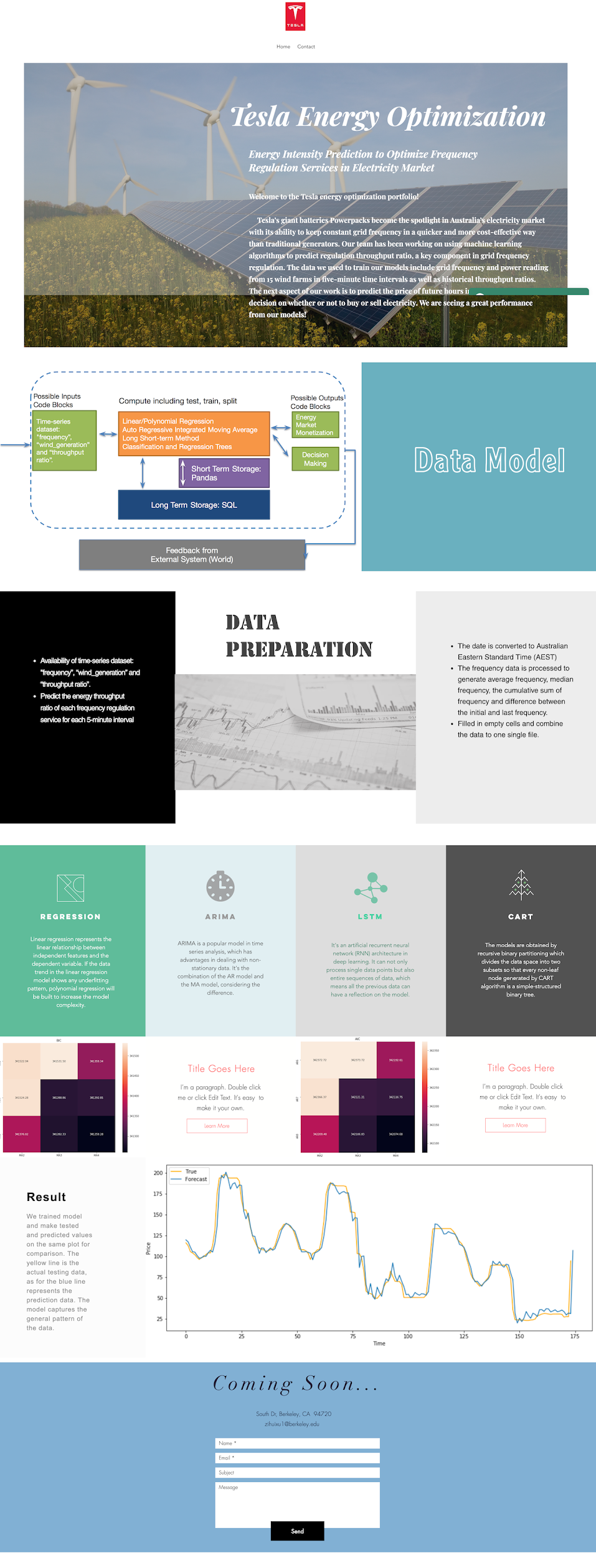
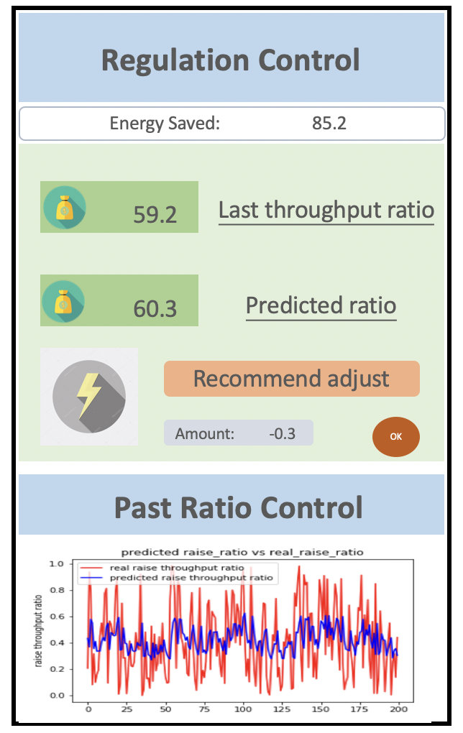
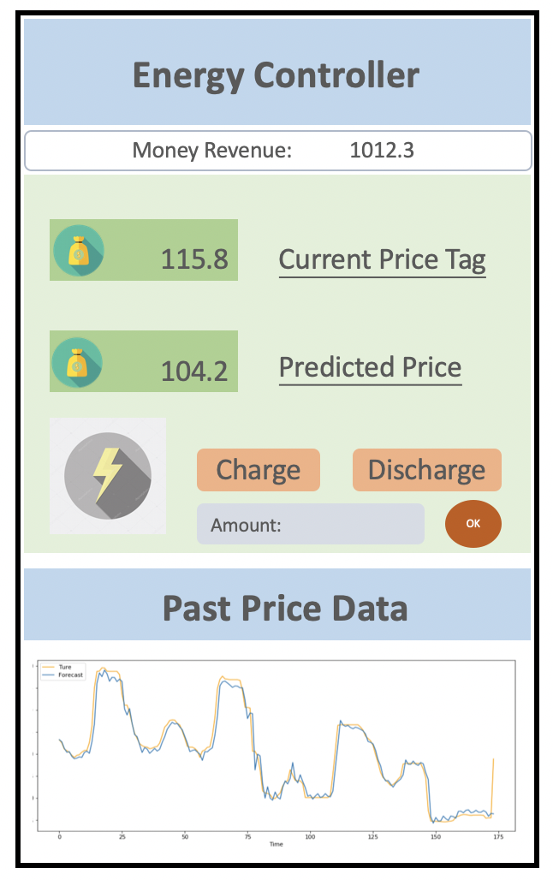
User Interface

Slide 7
Frequency Regulation
Linear Regression
Linear regression represents the linear relationship between:
Independent features:
power readings from 15 wind farms
5-min grid frequency (average, median, range, and sum)
Dependent variable:
regulation throughput ratio

Slide 8
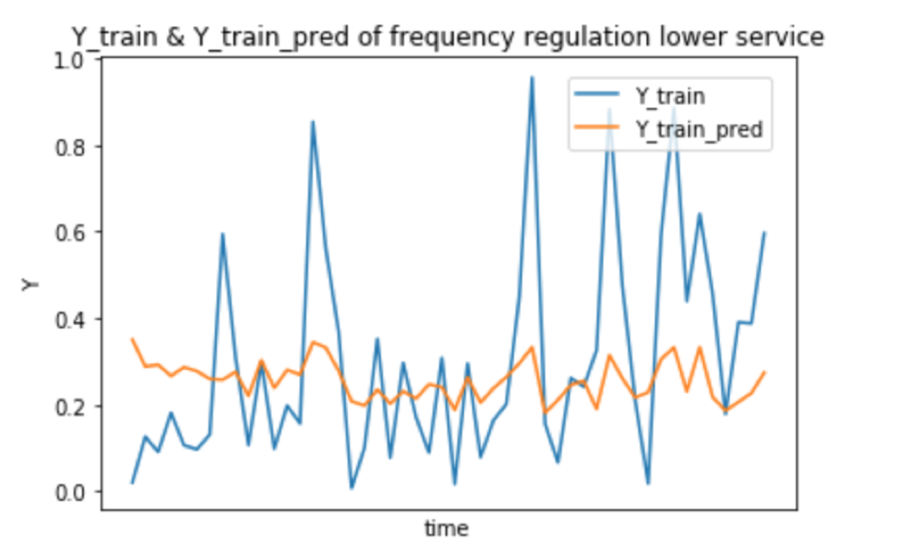
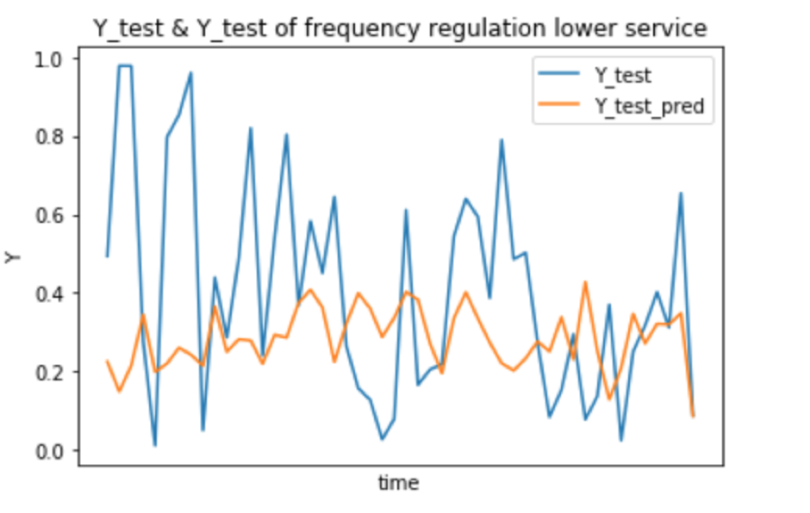
Frequency Regulation
Linear Regression
The MSE:
Training: 0.0449
Test: 0.0665

Slide 9
Frequency Regulation
LSTM
Long short-term memory (LSTM) model is used to predict throughput ratio. LSTM is a powerful artificial recurrent neural network (RNN) architecture in deep learning. Thanks to gate structures, LSTM has an outstanding performance in long time series prediction, which will avoid gradient explosion and vanish.
In the project, LSTM with 4 units and sigmoid function is built with Keras (Tensorflow backend). The model is trained over 20 epochs with an Adam optimizer.

Slide 10
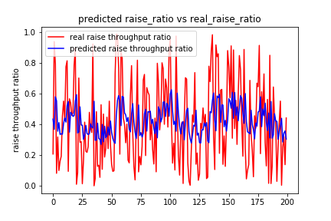
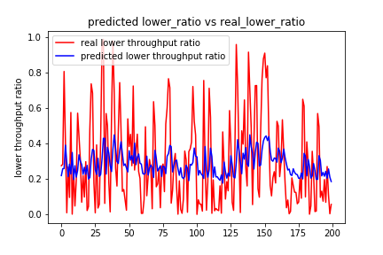
Frequency Regulation
LSTM
The model can successfully captures the trend of throughput ratio despite magnitude deviation.

Slide 11
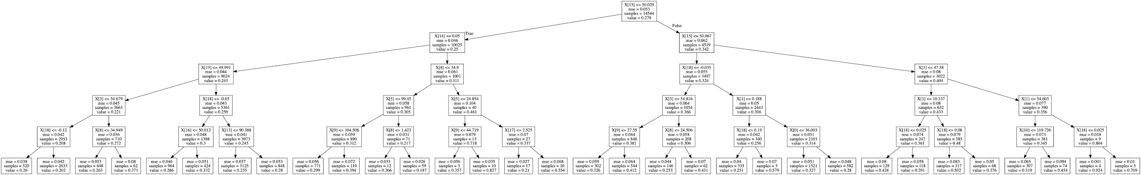
Frequency Regulation
CART
Cost function: MSE
Select parameters: GridSearchCV e.g. max_depth: 5
Two binary decision trees are constructed for frequency regulation lower and raise service.
The most important feature is 5-minute mean frequency for both models.
Notes:
5 mins mean frequency ?

Slide 12
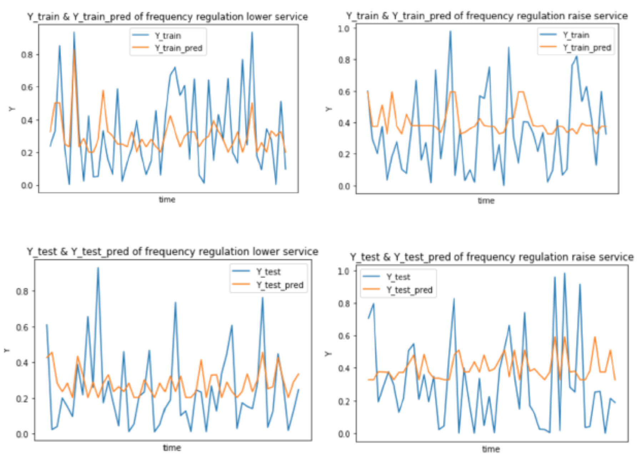
Frequency Regulation
CART
MSE
 | Frequency Regulation Lower Service | Frequency Regulation Raise Service
Train MSE | 0.04818 | 0.07009
Test MSE | 0.05070 | 0.07103

Slide 13
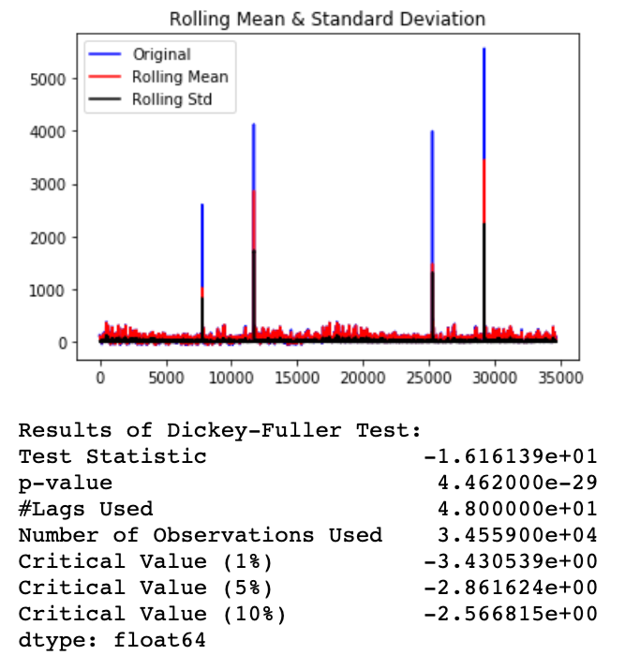
Predict Pricing
ARIMA
3 main parameters: p, d, q
Augmented Dickey-Fuller (ADF) test
P-value: 4.4689e-29 << 0.05
stationary
Differencing: not needed (d=0)

Slide 14
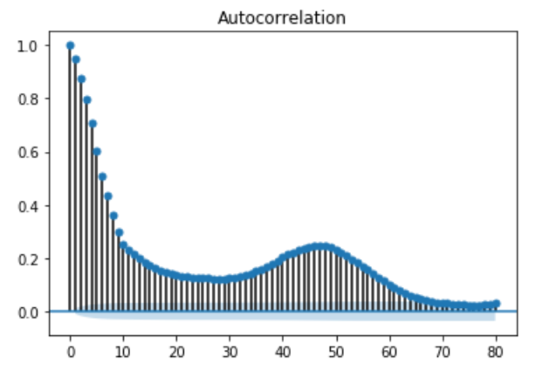
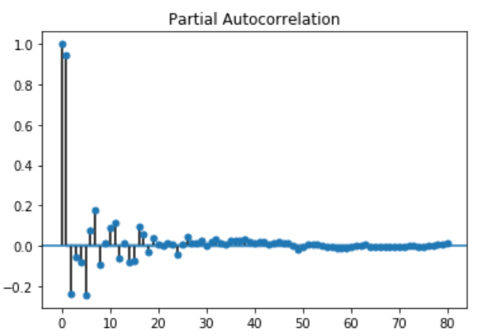
Predict Pricing
ARIMA
Autocorrelation function(ACF) and partial autocorrelation(PACF) plotted for the time series
AIC and BIC were used to tune parameters in Arima
Both BIC and AIC get the minimum values when p = 8, q = 4.

Slide 15
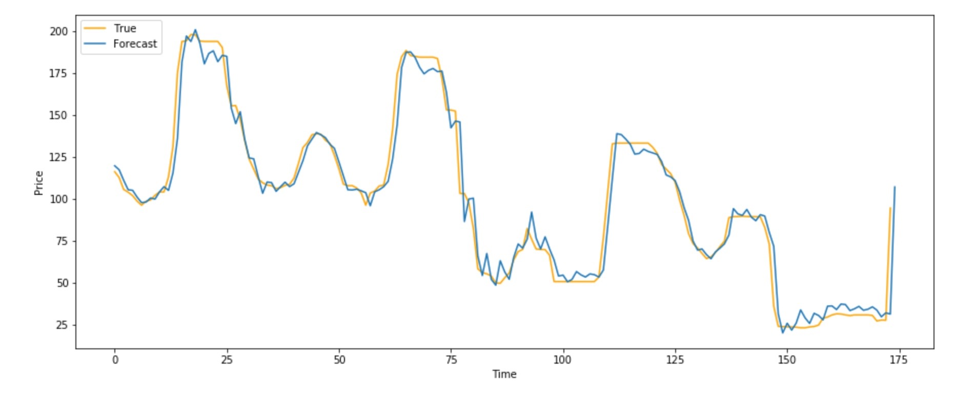
Predict Pricing
ARIMA
Predicted Value of One-step Forecast by Rolling ARIMA vs. True Values
mean absolute percentage error: 0.08

Slide 16
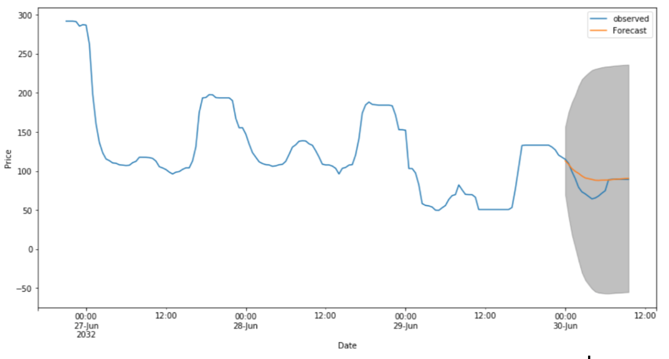
Predict Pricing
ARIMA
Predictions of 20 Timesteps by Using ARIMA with Confidence Interval of 80%
mean absolute percentage error: 0.139

Slide 17
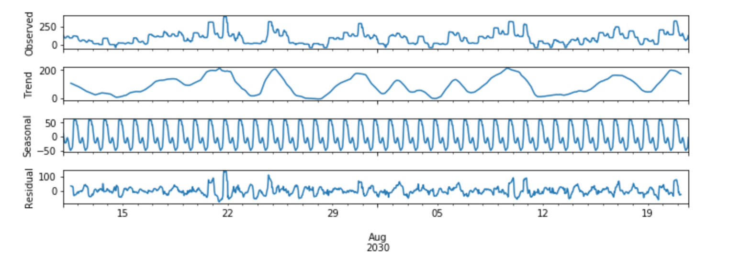
Seasonal Decomposition
y_{t}=S_{t}+T_{t}+R_{t}
where y_{t} is the data, T_{t} is the trend-cycle component, S_{t} is the seasonal component, and R_{t} is the remainder component, all at period t. The three components are shown separately in the bottom three panels of the figure.

Slide 18
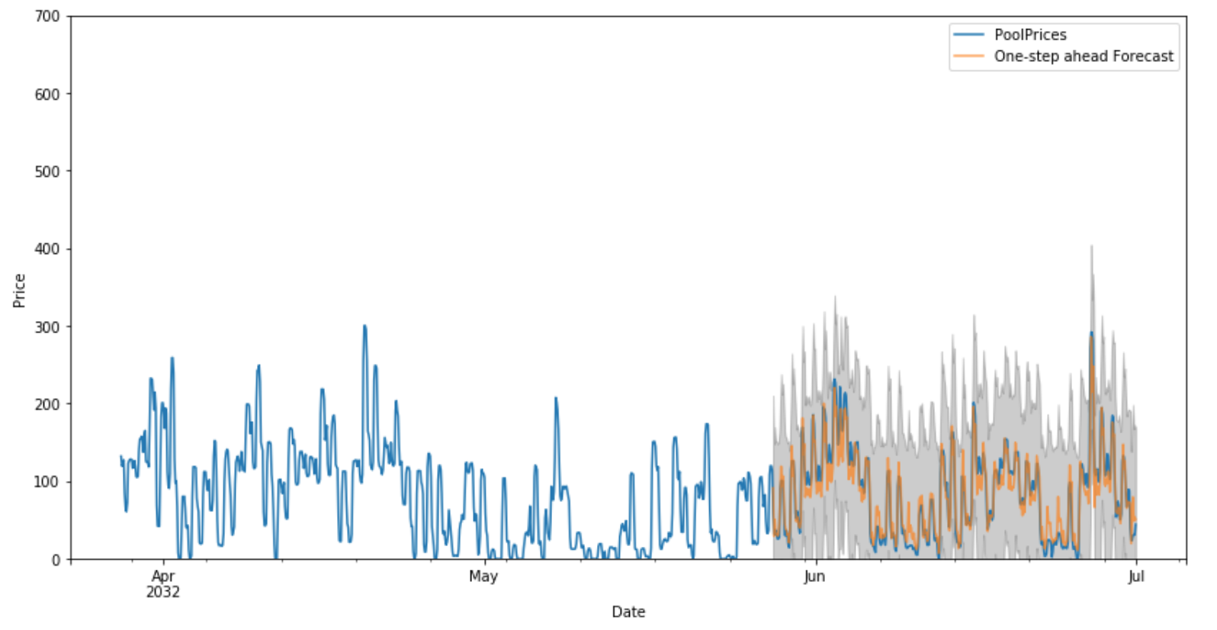
Predict Pricing
SARIMA
SARIMA model with parameters (2, 0, 1)x(2, 1, 2, 12) which obtains the lowest AIC value
Notes:
The number of time steps for a single seasonal period.

Slide 19
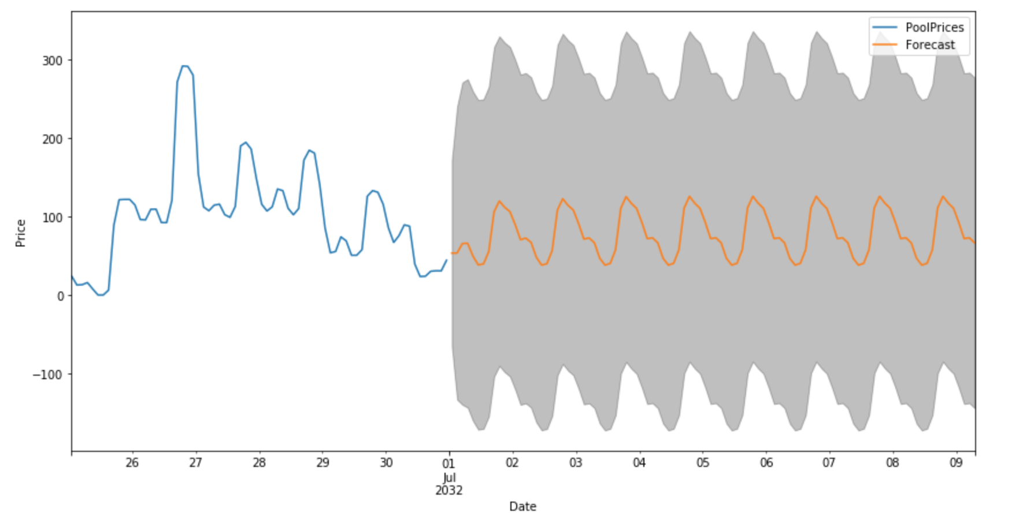
Predict Pricing
SARIMA
Sarima forecasts the future price in 100 time steps

Slide 20
Predict Pricing
LSTM
We take the advantage of Keras (Tensorflow as backend) to build neural network. The Sequential model is trained with Adam Optimizer and epoch of 20. The input data is an array of all prices 60 timesteps ago. The output is the following 10 timestep prices in the future. 10 timesteps are enough to take action based on the prediction (whether charge or discharge). Also, there will be suggestion based on the action prediction (next task).

Slide 21
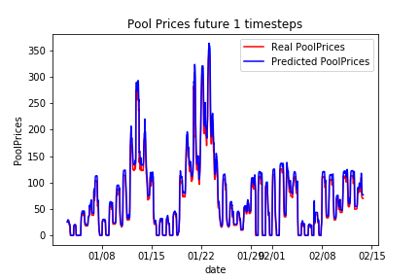
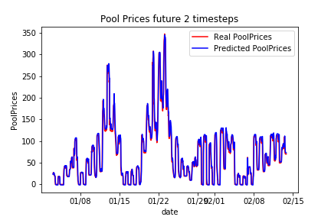
Predict Pricing
LSTM
The predicted and real prices (2000 data points plotted) are shown in the figure. The prediction complies well with the real prices, indicating satisfying performance of LSTM model.

Slide 22
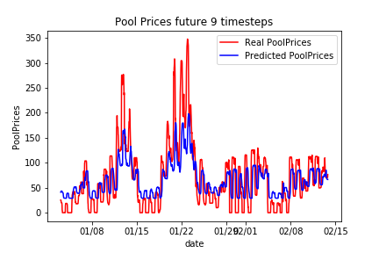
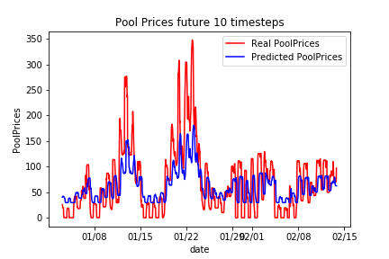
Predict Pricing
LSTM
The error increases in further future. The model can sometimes fail to predict long future’s sudden change. It is expectable because the model did not learn enough sudden changes from training data.

Slide 23
Predict Charging Action
Sequential
Main purpose: guide action (charge vs discharge)
Simplification: multi classification problem
Cases: charge, discharge, no action
Layers: Three (dense 64,32,3; activation function: relu, sigmoid, softmax)
Inputs: 20 previous timesteps’ price, charge, discharge, action (80 total)

Slide 24
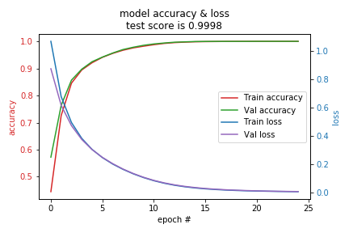
Predict Charging Action
Sequential
After training for 20 epoches, the model behaves well for the prediction as test accuracy is almost 1.

Slide 25
Conclusion
Throughput Ratio Prediction
The result from LSTM is more convincing than other regression methods (Linear regression, CART)
MSE 0.054 VS. MSE 0.06 VS. MSE 0.074
Improvement needed for the LSTM model or apply the Reinforcement Learn for future work
Price & Action Prediction
Both Rolling ARIMA and SARIMA can predict well on the one step forecast
For the future forecast, the models become less confident in our values
The RNN Sequential model is accurate on predicting the charging, discharging actions
Improvement: More features (e.g. economic status) and constraints (e.g. Battery capacity,charging efficiency) are needed

Slide 26
Thanks!
GitHub: IEOR_Tesla_final
https://github.com/hideonbushJ/IEOR_Tesla_final

